Slide 1

WELCOME
Check Me Out!
Evaluating Advertising Within Attractions.

Slide 2

TODAY WE’LL DISCUSS
WHO WE ARE
WHY TARGETING IS ESSENTIAL
Next level marketing!
ASSESSING EXPOSURE TO FIND OPPORTUNITIES
CREATING A GAME PLAN
USEFUL TOOLS & STRATEGIES
BRINGING IT ALL TOGETHER

Slide 3
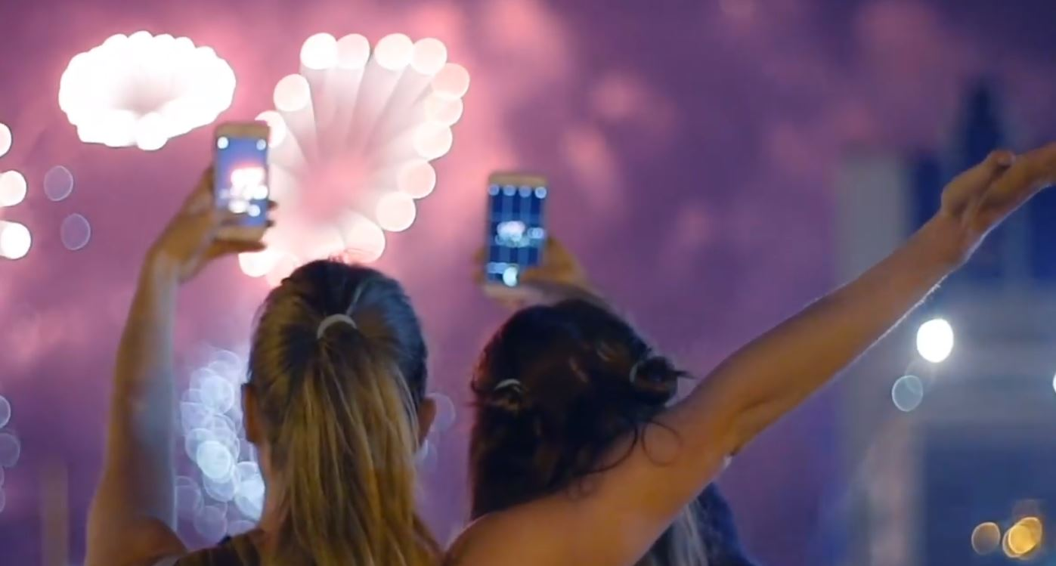
About Us
Von Mack
Hi! We’re a collaborative of award winning tourism and event marketers who believe in the power of experiential messaging.
We understand that evoking feeling is the most important element in your market sector – and that’s something we do well.
Our Services
Our Mission
Integrated Campaigns, Brand Identity, Websites, SEO, Paid Search, SoMo, Photography & Video, Print Creative, Consulting, Workshops
To drive tangible sales and traffic for businesses in the tourism, events, hospitality & lifestyle business sectors.

Slide 4
Why Targeting Is Essential
Don’t waste your marketing dollars! Connect with those who are most likely to buy.
AFFINITIES
DEMOGRAPHICS
Why types of things does your target market love?
What persona does the data create? Think income, age, location…
BEHAVIOR
PSYCHOGRAPHICS
What are some common behaviors in general & prior to making a purchase?
Think about their attitudes and aspirations.
TOUCH POINTS
THOUGHT PROCESSES
What mediums does your target market frequent?
Purchase Funnel Behaviors

Slide 5
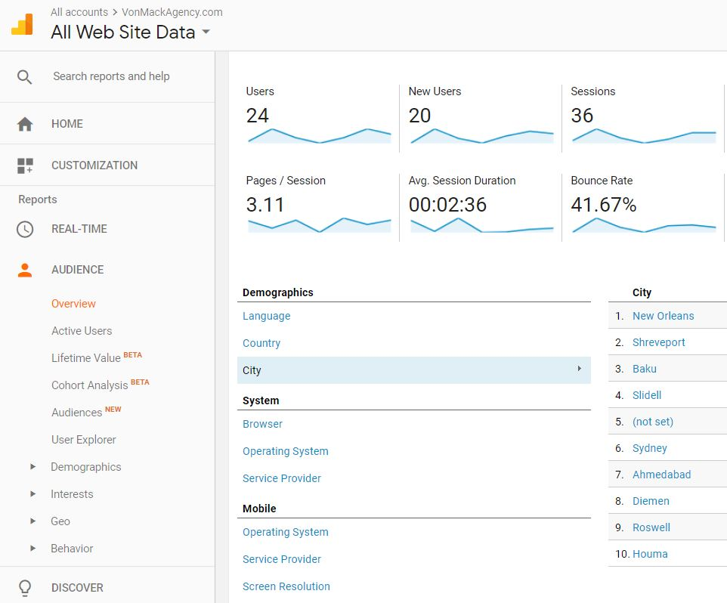
Assessing Exposure To Find Opportunities
Use data from where you are now to see where you can be.
57%
GO DIGITAL
Over 57% of all travel purchases are researched online, so look to your website stats to set a data foundation.
https://www.statisticbrain.com/internet-travel-hotel-booking-statistics/
ANALYSIS
80%
FIND THE DECISION MAKERS
According to Forbes, women make up to 80% of travel based decisions. Does your data reflect the same?
https://www.forbes.com/sites/ceciliarodriguez/2014/04/21/paris-one-girls-guide-to-leveraging-womens-travel-spend/#4abcd0013d96

Slide 6
General “Top Of Mind” Data
More Data Points To Discover The Target Market
Industry Trends Data
Digital Behavioral Data
Reservations Data
Opportunity Data
Booking System & Reservations Reports
Official Research On Visitation Trends (CVB, State Data)
Front Line Agent Interviews
Social Media Reporting
Coupon Tracking
Group Sales Reporting
FAQs & Common Questions
OTA Data
TARGET MARKET PROFILE
Focus on creating 2-3 profiles before delving into planning.

Slide 7


Target Profile Examples
Get To Know Who Your Marketing Will Speak To!
Targeting your paid placements most effectively entails knowing exactly who you’re speaking to.
While it’s difficult to make one ad speak to all market profiles, you can position placements within your plan to speak effectively to top performing demo’s.
Look for which profiles bring the most ROI. What do the top profiles have in common? How do they differ?
“Travel Planner Moms”
Regional Drive & Local Geo
“Baby Boomer Travelers”
Plans trips 5 weeks out or more
Uses social media (and reviews) heavily to build itineraries for family
Most likely to drive to destinations
Looks for quality & discount offers
Luxury Travel Market
Likes maps, brochures, physical guides
Interested in quality over discounts
Looking for cultural experiences & small groups

Slide 8
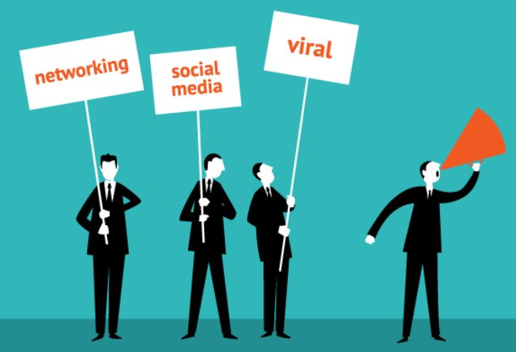
Creating A Game Plan
Now that you have your profiles, let’s discuss how to target your market efforts to reach them most effectively.
Our goal is to seek out the correct people, engage them with our message, and convert them to a sale!
After we’ve completed this cycle, we’ll use the data to continually optimize efforts and increase ROI.
ALWAYS ALWAYS ALWAYS TRACK YOUR EFFORTS.
SEEK
ENGAGE
CONVERT
PERFECT THE MESSAGE: Does your creative speak to the target?
Do the pictures in your marketing illustrate people who represent your profiles?
Do the calls to action line up with their interests? (ie if they are deal based, are coupons available?
Are you using messaging that works best with mediums?
DRIVE TOWARDS PURCHASE: Do your placements move the needle from engagement towards an action?
Create a sense of urgency.
(ie “24 hour promo only”)
Experiment with exclusivity. (“Locals only day.”)
Community (Reviews, etc)
INTEREST: Where do our most important profiles go when researching travel purchase decisions?
Digital? What sites?
Brochures? Where do they pick them up?
Are some mediums important for research but not actual reservations? (purchase funnel)

Slide 9
Useful Tools & Strategies
The Digital Realm
Get Creative In Connecting With Your Target
1
2
3
4
5
6
CONTENT TYPES
HYPER TARGETED CAMPAIGNS
WEBSITES STRATEGIZED TO CONVERT
MOBILE CAMPAIGNS & MOBILE ONLY OFFERS
OTA PARTNERSHIP OPTIMIZATION
RELATIONSHIP BASED MARKETING
Good photography and video is worth its weight in gold – excellent for exposure and sharing.
Make sure that bloggers, CVB & other mediums have your best assets. Use video for top engagement in somo campaigns.
PERSONALIZE CONTENT TOPICS TO CORRELATE W INTEREST DATA.
GEO: Break up your targeting on paid search & social media campaigns to speak with a different message to those in 30 minute drive range.
For example, for Adwords, target local proximity and stick to broad phrases for PPC. For Somo, explore timely discounts.
Always drive traffic to your site and make sure that your website is positioned to convert quickly.
Take social media icons and put at bottom.
Implement reviews, deals, sense of urgency, promo codes.
Revamp your messaging to reflect well on mobile and experiment with mobile only targeting to get a good bang for your buck.
During low season, work with your OTA’s to get the most out of their promo offers.
Steer clear of Groupon, etc., if you can for best ROI.
Make sure there’s an email sign up on your website and then use it for newsletters with offers.
Utilize email list for PPC & Somo ad targeting.

Slide 10
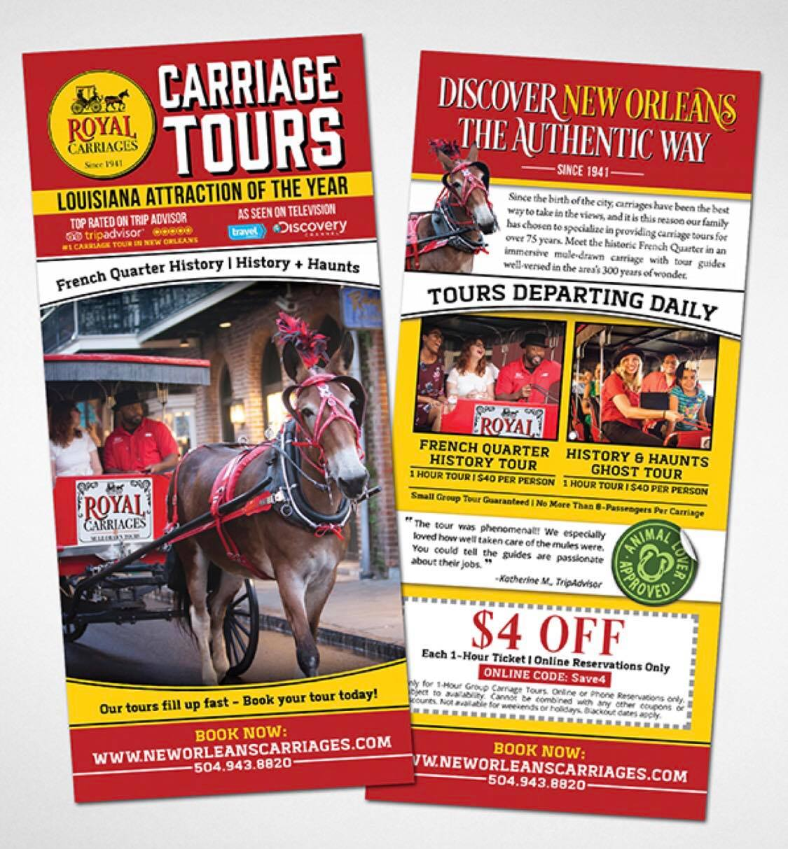
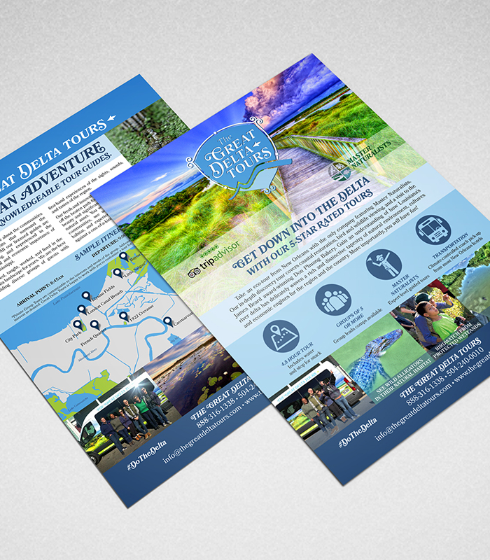
Useful Tools & Strategies
Optimizing Print
LEISURE TRAVEL
GROUP TRAVEL
Brochures, Print Ads, Etc.
Profile Sheets, Group Planner Ads
Choose ad placements and brochure racks which correlate to your geo / behavioral market data. (For example, do you serve RV’ers? Where can you buy a placement to reach them most effectively?)
Make sure artwork has strong imagery illustrating others using your product.
Utilize strong calls to action, reviews, sense of urgency, and unique selling proposition.
Track placement effectiveness with coupon codes, unique URLS, etc.
Try to pick placements where you can “compound efforts.” (ie magazines where your audience will also see you at the sales show.)
Highlight ease of booking for group planners.
Use unique selling points for group planners to resell the idea to their groups! (ie “most comprehensive tour of ….”)
Illustrate groups in imagery.
Use map and call outs for quick planning logistics comprehension.

Slide 11
Useful Tools & Strategies
Tools for creating, targeting & optimizing placements.
CYFE
CANVA
GOOGLE ADWORDS
Cyfe.com
Real time dashboard that pulls in most forms of reporting in one place. Also generates reports.
Canva.com
Free tool that facilitates easy creation of social media creative, various types of artwork, fliers and more.
Adwords.Google.com
Google’s interface to purchase ads for keywords in their SERPS and beyond.
FACEBOOK ADS MANAGER
MAILCHIMP
GOOGLE OPTIMIZE
Facebook.com/AdsManager
Go here to create an account for super targeted FB ads. Go beyond the simple boosted post! THINK: A / B testing, targeting visitors to town only, lead creation ads.
Mailchimp.com
Easy to install, simple to manage email signup form for your website and email deploy system. PRO TIPS: Send out messages on Tuesdays during early afternoons, use subjectline.com to optimize email subject lines for optimum open rates, use email database for future ad targeting!
Google.com/Analytics/Optimize
Use Optimize to test your website for conversion rates – you can test placement of booking buttons, color if call to action graphics, and more for various audiences!

Slide 12
BRINGING IT ALL TOGETHER
Creating & Implementing Your Master Plan
1) DISCOVER YOUR TARGETS
2) PURCHASE PLACEMENTS TO REACH TARGETS DIRECTLY
Look to as many data points you can find to create your top three market personas.
Use marketing dollars to “harpoon” the best leads – not “sprawl an all-encompassing net to everyone.” Look into behavioral targeting, geo targeting, and types of mediums in general.
3) STRATEGIZE PLACEMENT CREATIVE TO ENGAGE & CONVERT
4) TRACK PLACEMENTS & REVAMP IF NEEDED FOR PERFORMANCE
Ensure that creative placed in media channels will be effective in converting to a sale. A muddled message may not work even with the best targeting there is.
Use tracking ID’s, unique urls, unique phone numbers, coupon codes, and everything available to track each message you deploy. Watch for performance indicators and tweak to ensure that media buys drive sales.
BUILD YOUR CAMPAIGNS FOR SUCCESS
Once you’ve set a solid foundation of targeting, creative, and metrics, you’ll be able to set up experiments to catch 3rd & 4th tier markets. You may also be surprised at how demo’s react to your placements! You may be able to discover opportunities for product development and cross marketing which you didn’t even know existed.

Slide 13
Questions?
Thank you for joining us today!
Email: Marica@VonMackAgency.com
Website: VonMackAgency.com
Facebook @ VonMackAgency | Instagram @ VonMackAgency | LinkedIn @ The Von Mack Agency
We love feedback. Leave us a review!

